Slide 1
Advertising Examples
Examples of Printed Advertisements from Three Companies/Corporations

Slide 2
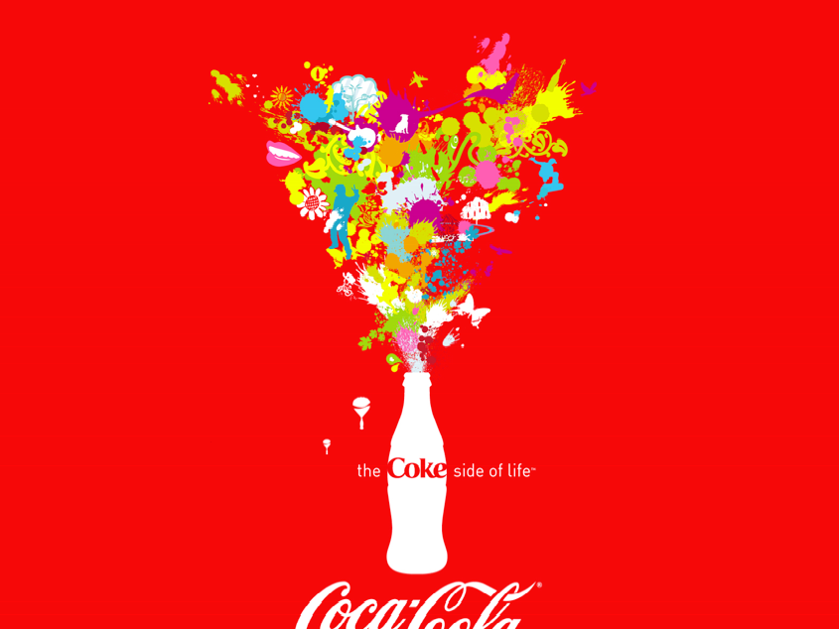
Coca-cola
Coca-Cola Advertising
#1 Santa Claus with a coke bottle
#2
#3 “Old-school celebrities on a bottle of coke. Tagline: “A classic never goes out of style.

Slide 3
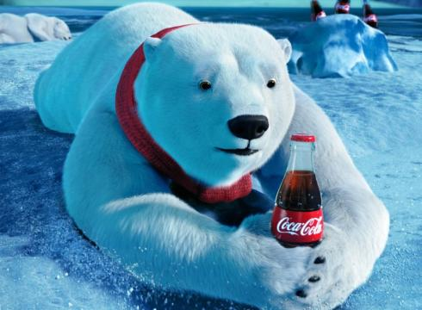

Slide 5
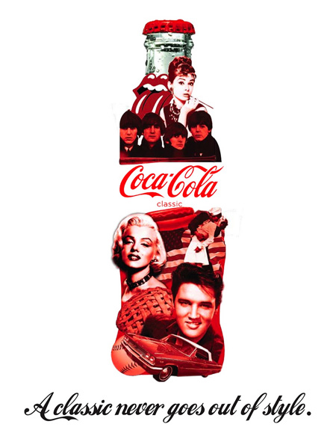

Slide 6
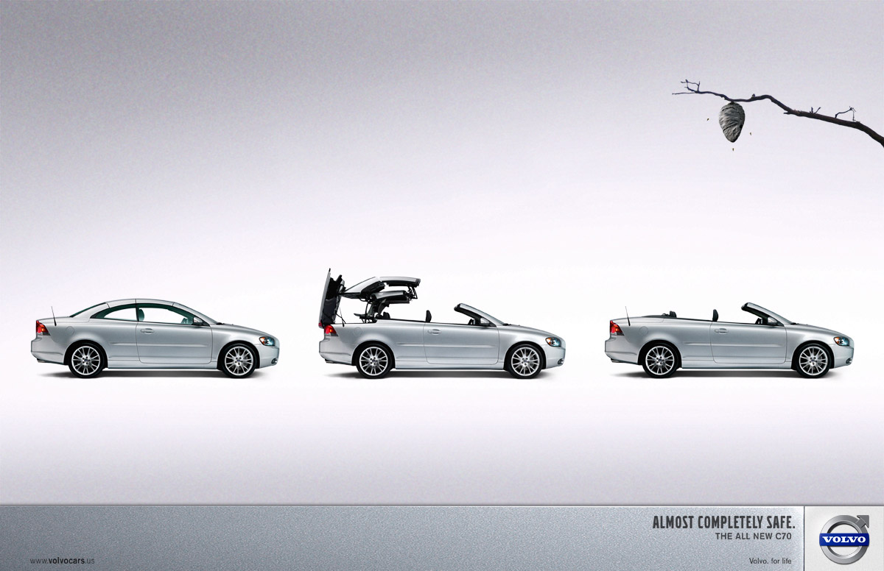
Volvo Advertising

Slide 8
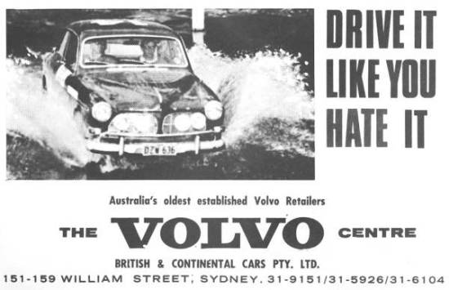

Slide 9
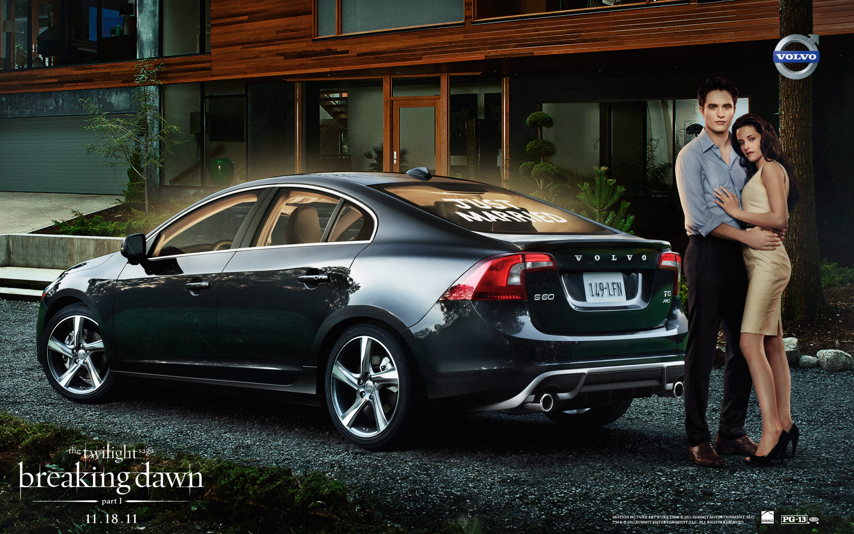

Slide 10
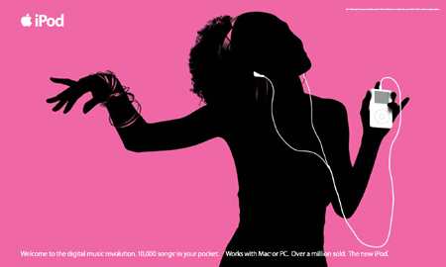
Apple Advertising

Slide 12
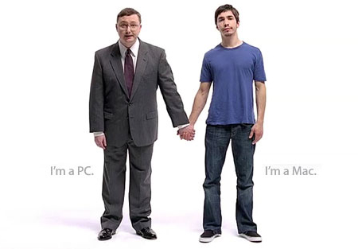

Slide 14
Advertising Project: Sell 1 Item in 3 Advertisements
YOU ARE THE MARKETER OF A NEW PRODUCT

Slide 15
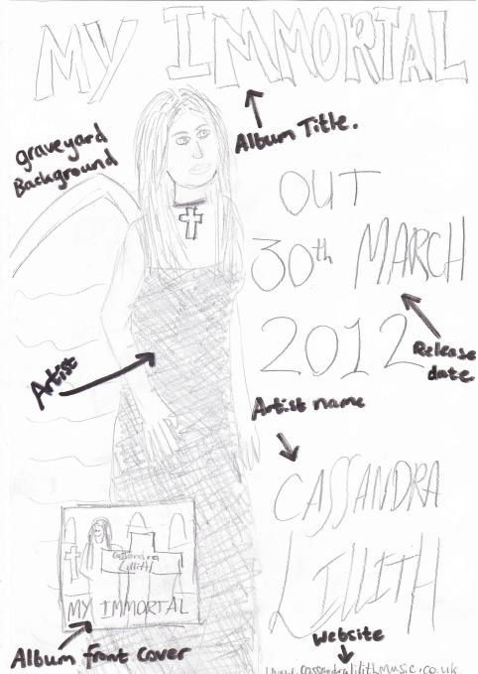
Step I
Make some sketches of the layout concept, design ideas and a prototype draft.
Include a logo, slogan, picture(s)
Make it aesthetically-appealing

Slide 16
Look at some examples to get ideas for your projects.
Look at the Photoshop tutorials that show you how to create the same effects that you see in these graphic designs.
Take 50 pictures of ordinary objects or scenes of people selling the objects.

Slide 17
Step II
Download photos or scan sketches
Drag into Photoshop files and manipulate.

Slide 18
Step III
Use at least 10 persuasive strategies in your ads. Examples:
Strong wording
Glamorizing product image
Pictures of attractive people
Humor
Bright colors
Uses metaphors

Slide 19
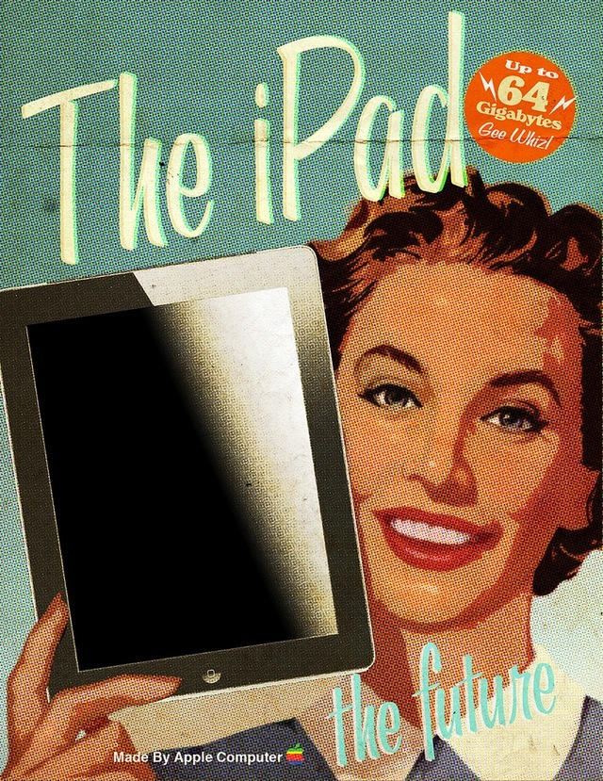
Step IV
Use at least 5 PS techniques/strategies
Enlarge product/shrink person
Paste objects into different backgrounds
Add texture
Add sparkles, stars
Airbrush subjects

Slide 20
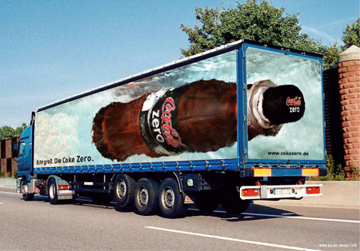
Other Notes
Save project Last name—First name—Project name
Key Words That Sell:
Bigger, better
The best..The most
The Newest
New and Improved
Limited Time Offer
Fresh
Prize

Slide 21
STEPS FOR ADVERTISEMENT PROJECT
Get your computer number
Log in adobe/adobe
Take 50 pictures of your item
Download into i-photo and make a folder for these photos, labeled: Advertisement
Choose an image (or several) to use and drag and drop into photoshop
Resize your image to 8 x 10
SAVE AS: _________(title) in YOUR FOLDER (with your name on it)
Make new layers - Drag out your layers bar for easy access
Open Windows: History, use this to “go back” in your editing
Open Windows: Filters; use filters to manipulate your images
Add text/persuasive wording & a SLOGAN: think color, contrast, font choice,
Edit: Transform (allows you to move, resize, rotate, warp text)
DRAW An original LOGO using the Paintbrush/Pen/Shapes tools
EDIT: Transform
Change the size of something in your photo, rotate it, warp it, move it…
Image: Adjustments
Adjust color, make black & white, saturate…
Add, Subtract elements, manipulate to create a cohesive composition
YOU MUST SHOW USE OF AT LEAST 5 Photoshop tools
When finished, get feedback from teacher
LAYERS: Flatten image
“SAVE AS” a JPEG
Post to your website under PHOTOSHOP Tab
Email link to: lrankin@losd.ca
NOW, start back at step 5 with your next idea (total of 3 ads for the same product due by Friday, 10/25)

