Slide 1
Neil Simon
World’s most successful playwright.
Prolific output, writing more than fifty plays and screenplays
Has won Tony Awards, Emmys, a Golden Globe and a Pulitzer Prize for his work
Has never won an Academy Award but has been nominated on four occasions for Best Screenplay
Has received more Academy and Tony nominations than any other writer
The only playwright to have four Broadway productions running simultaneously
His plays have been produced in dozens of languages and have been acclaimed successes from Beijing to Moscow

Slide 2
Neil Simon
Born in the Bronx on July 4, 1927
Full Name: Marvin Neil Simon
Grew up in Manhattan
For a short time attended NYU and the University of Denver

Slide 3
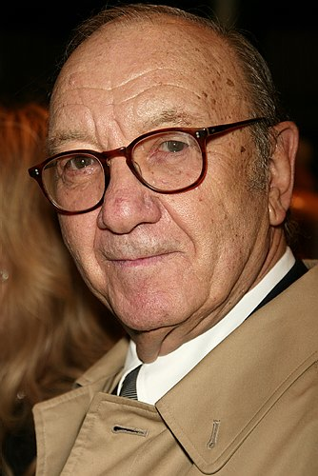
Neil Simon
1940s he worked as a newspaper editor and then as a radio scriptwriter, learning conciseness.
1950s wrote for Your Show of Shows, a landmark live television comedy series, working with some of the best comedic writers of the day, including Woody Allen. Simon attributes this collaboration as the experience most influential to his writing.
1960s began concentrating on writing plays for Broadway.

Slide 4
The Works of Neil Simon
Plays
Plays
Come Blow Your Horn (1961)
Little Me (1962)
Barefoot in the Park (1963)
The Odd Couple (1965)
Sweet Charity (1966)
The Star-Spangled Girl (1966)
Plaza Suite (1968)
Promises, Promises (1968)
The Last of the Red Hot Lovers (1969)
The Gingerbread Lady (1970)
The Prisoner of Second Avenue (1971)
The Sunshine Boys (1972)
The Good Doctor (1973)
God’s Favorite (1974)
California Suite (1976)
They’re Playing Our Song (1979)
I Ought to Be in Pictures (1980)
Fools (1981)
Brighton Beach Memoirs (1983)
Biloxi Blues (1985)
The Female Odd Couple (1986)
Broadway Bound (1986)
Rumors (1988)
Lost in Yonkers (1991)
Jake’s Women (1992)
The Goodbye Girl (1993)
Laughter in the 23rd Floor (1993)
London Suite (1995)
Proposals (1997)
The Dinner Party (2000)
45 Seconds to Broadway (2001)
Rose’s Dilemma (2003)
Oscar and Felix: A New Look at the Odd Couple (2004)

Slide 5
The Works of Neil Simon
Screenplays
Screenplays
After the Fox, United Artists (UA), 1966.
Barefoot in the Park (based on his play), Paramount, 1968.
The Odd Couple (based on his play), Paramount, 1968.
Sweet Charity, Universal, 1969.
The Out-of-Towners, Paramount, 1970.
Plaza Suite (based on his play), Paramount, 1971.
Star-Spangled Girl (based on his play), Paramount, 1971.
The Heartbreak Kid, Twentieth Century-Fox, 1972.
Last of the Red Hot Lovers (based on his play), Paramount, 1972.
The Prisoner of Second Avenue (based on his play), Warner Bros., 1975.
The Sunshine Boys (based on his play), UA, 1975.
Murder by Death, Columbia, 1976.
The Goodbye Girl, Warner Bros., 1977.
California Suite (based on his play), Columbia, 1978.
Chapter Two (based on his play), Coumbia, 1979.
Seems Like Old Times, Columbia, 1980.
(With Danny Simon) Only When I Laugh (also known as It Hurts Only When I Laugh; based on his play (The Gingerbread Lady), Columbia, 1981.
I Ought to Be in Pictures (based on his play), Twentieth Century-Fox, 1983.
Adapter (with Ed Weinberger and Stan Daniels), The Lonely Guy, Universal, 1984.
The Slugger's Wife, Columbia, 1985.
Brighton Beach Memoirs (based on his play), Universal, 1988.
The Marrying Man, Buena Vista, 1991.
Neil Simon's "Lost in Yonkers" (based on his play), Columbia, 1993.
The Odd Couple II, 1998.
The Out-of-Towners (based on his play), (1970 screenplay) 1998.
The Heartbreak Kid, (1972 screenplay) 2007

Slide 6
The Works of Neil Simon
Television Series
Television Movies
(With Danny Simon) The Phil Silvers Arrow Show, NBC, 1948.
Your Show of Shows, NBC, 1950-54.
The Tallulah Bankhead Show, NBC, 1951.
The Sid Caesar Show (also known as Caesar's Hour), NBC, 1956-57.
Sid Caesar Invites You, ABC, 1958.
(With Danny Simon and Mel Brooks) The Phil Silvers Show (also known as Sergeant Bilko), CBS, 1958-59.
The Garry Moore Show, CBS, and A Quiet War, 1976.
Plaza Suite (based on his play), ABC, 1987.
Neil Simon's "Broadway Bound" (based on his play), ABC, 1992.
The Sunshine Boys (based on his play), Hallmark Entertainment, 1995.
London Suite (based on his play), 1996.
Jake's Women (based on his play), 1996.
Laughter on the 23rd Floor (based on his play), 2001.
The Goodbye Girl, (1977 screenplay) 2004.

Slide 7
The Works of Neil Simon
Television Specials
Radio Series
The Trouble with People, NBC, 1972.
Writer for:
Love, Life, Liberty, and Lunch, 1976.
The Sunshine Boys (based on his play), 1977.
Barefoot in the Park (based on his play), 1982.
"Big Joe and Kansas," a segment of Happy Endings, 1975.
Adapter of Material for:
Best Foot Forward
Dearest Enemy
Connecticut Yankee
The Robert Q Lewis Show, CBS
(with Danny Simon) Goodman Ace, CBS.
Memoirs
Rewrites: A Memoir. Simon & Schuster. Oct. 7, 1996.
The Play Goes On: A Memoir. Simon & Schuster. July 1, 1997.

Slide 8
Neil Simon’s Prolificacy
Note the immediate, hyper frequency of Simon’s prolificacy
Example:
The Prisoner of Second Avenue (1971)
The Sunshine Boys (1972)
The Good Doctor (1973)
Usually no more than three years between works being, not written, but produced

Slide 9
Neil Simon’s Awards and Honors
1956, 1957
Emmy Award Nomination for Best Writing in a Variety or Situation Comedy
The Sid Carson Show
1959
Emmy Award Nomination
The Phil Silvers Show
1963
Tony Award Nomination for Best Author of a Musical/ Best Musical Play
Little Me
1964
Tony Award Nomination for Best Play
Barefoot in the Park
1965
Tony Award Winner for Best Dramatic Author
The Odd Couple
1966
Tony Award Nomination for Best Musical
Sweet Charity
1967
Writers Guild Award Nomination for Best Screenplay
Barefoot in the Park
1967
Evening Standard Award
1968
Sam S. Shubert Foundation Award
1968
Academy Award Nomination and Writers Guild Award for Best Screenplay Based on Material from Another Medium
The Odd Couple
1969
Tony Award Nomination for Best Musical
Promises, Promises
1970
Tony Award nomination for Best Play
Last of the Red Hot Lovers
1972
Tony Award Nomination for Best Play
The Prisoner on Second Avenue
1973
Writers Guild Award and Tony Award Nomination for Best Play
The Sunshine Boys
1974
Shared Tony Award Nomination for Best Score
The Good Doctor
1975
Academy Award Nomination for Best Screenplay Adapted from Other Material
The Sunshine Boys

Slide 10
1968
Sam S. Shubert Foundation Award
1968
Academy Award Nomination and Writers Guild Award for Best Screenplay Based on Material from Another Medium
The Odd Couple
1969
Tony Award Nomination for Best Musical
Promises, Promises
1970
Tony Award nomination for Best Play
Last of the Red Hot Lovers
1972
Tony Award Nomination for Best Play
The Prisoner on Second Avenue
1973
Writers Guild Award and Tony Award Nomination for Best Play
The Sunshine Boys
1974
Shared Tony Award Nomination for Best Score
The Good Doctor
1975
Academy Award Nomination for Best Screenplay Adapted from Other Material
The Sunshine Boys
1975
Tony Award for Over-All Contributions to the Theatre
1975
Writers Guild Award
1977
Academy Award Nomination for Best Original Screenplay
The Goodbye Girl
1978
Golden Globe Award for Best Screenplay
The Goodbye Girl
1978
Academy Award Nomination for Best Screenplay Adapted from Other Material
California Suite
1978
Tony Award Nomination for Best Play
Chapter Two
1979
Tony Award nomination for Best Book of a Musical
They’re Playing Our Song
1979
Laurel Award, Writers Guild of America
1981
Honorary L.H.D. Degree from Hofstra University
1983
New York Drama Critics Circle Award for Best New Play
Brighton Beach Memories
1984
Honorary D.H.C. Degree from Williams College
1985
Tony Award for Best Play
Biloxi Blues

Slide 11
1987
Tony Award for Best Play
Broadway Bound
1989
Lifetime Creative Achievement Award, American Comedy Awards, George Schlatter Production
1991
Pulitzer Prize for Drama
Lost in Yonkers
1991
Tony Award for Best Play
Lost in Yonkers
1991
Drama Desk Award for outstanding new Play
Lost in Yonkers
1995
Kennedy Center Honoree
1996
Peggy V. Helmerich Distinguished Author Award
1996
UCLA Medal
1997
William Inge Theater Festival Award for Distinguished Achievement in the American Theater
2006
Mark Twain Prize for American Humor
Like his canon, note the immediate, hyper frequency and esteem of Simon’s accolades, the best in the business.

Slide 12
Neil Simon’s Humor
Simon created humor from the lives and troubles of everyday people.
Of Simon, actor Jack Lemmon said, “Neil has the ability to write characters — even the leading characters that we’re supposed to root for — that are absolutely flawed. They have foibles. They have faults. But, they are human beings. They are not all bad or all good; they are people we know.”

Slide 13
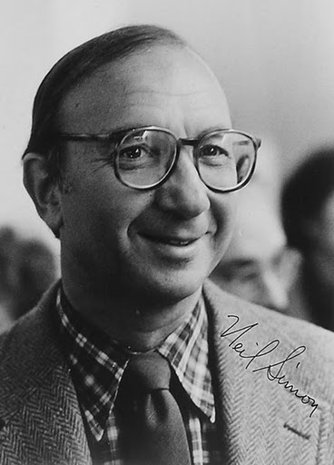
Neil Simon
Paul Reiser said, “When I was a kid growing up in New York, there were only a few things you could count on with any confidence. You knew the Yankees would be playing in the Bronx; you knew the Daily News would be saying nasty things about Mayor Lindsey; and there was always going to be a Neil Simon play on Broadway. Just always. It was a staple of life.”

Slide 14
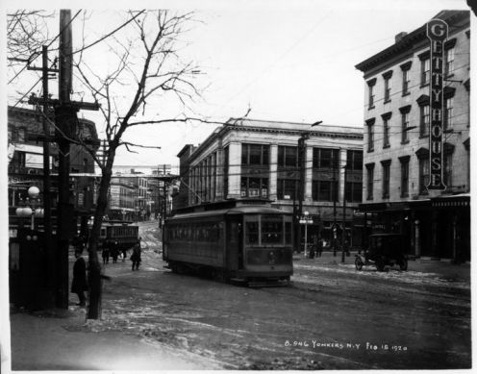
Lost in Yonkers
Takes place in Yonkers, NY in 1942
Main characters
Arty: 13 ½
Jay: almost 16
Eddie: 40s, Arty & Jay’s father
Bella: mid 30s, A & J’s aunt, “kid’s brain stuck in a woman’s body”
Louie: 36ish, A & J uncle, may have mobster ties
Grandma Kurnitz: 70s, owns a candy store, German immigrant

Slide 15
Takes place during WWII…
WW II was the focus
Things were rationed to make sure everyone had enough
Jeep, Slinky, Velcro, Tupperware, Frisbee introduced
Everything was geared towards anti-Japanese and anti-German
Taken from retrowaste. www.retroswaste.com/1940s/. 12 Feb. 2015. Web

Slide 16
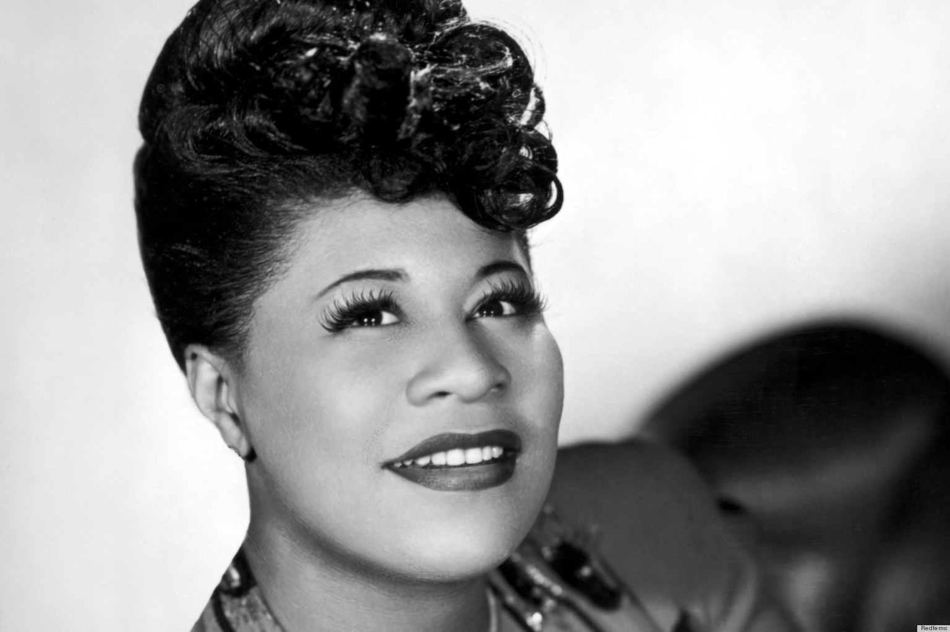
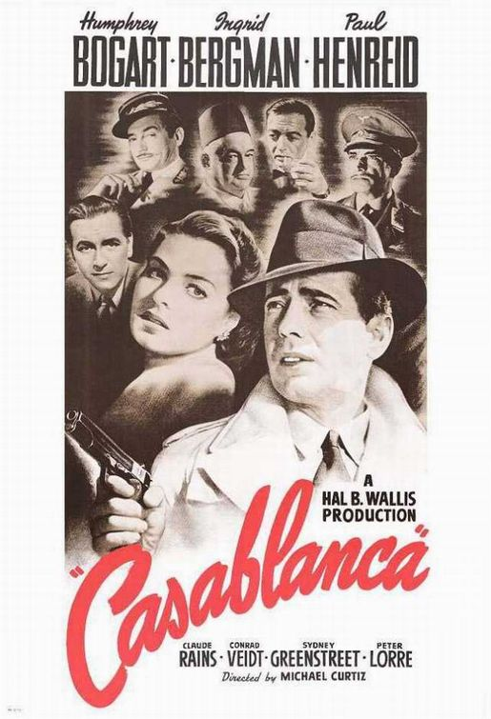
Post WWII
Jazz (Louis Armstrong & Ella Fitzgerald)
Radio listening, although a lot of music censored so was mostly talk radio
Movies – Casablanca, Grapes of Wrath; Movie stars – Jimmy Stewart, Abbott & Costello
Notes:
Some families not have electricity so used battery powered

Slide 17
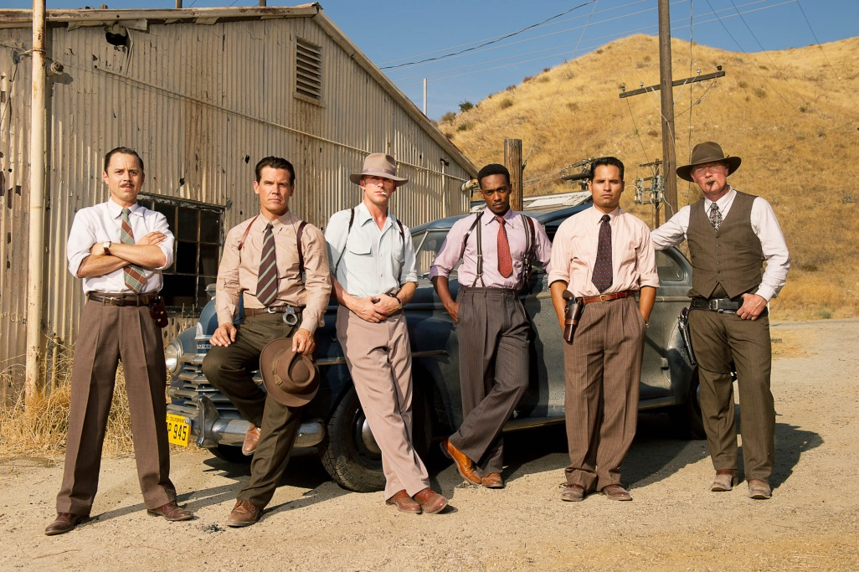
40s fashion and cars

Slide 18
Preview of Film
https://www.youtube.com/watch?v=cgGdgxAcaLI

